Slide 1
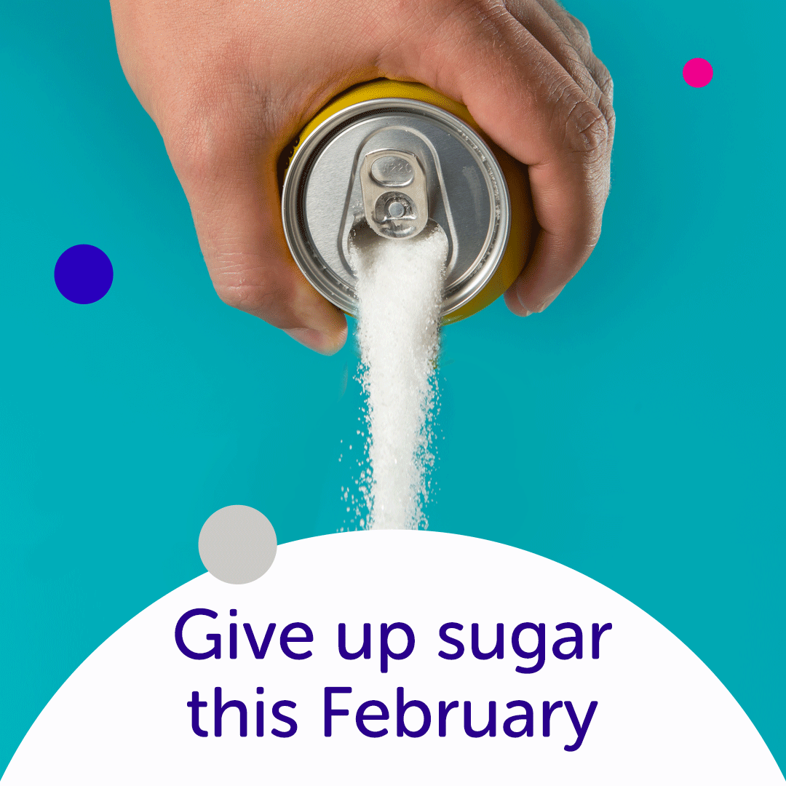

Notes:
Today I’m going to talking about the Sugar free February Campaign that took place in 2017, in an effort to get more people to cut down on sugar.

Slide 2

Why is cutting down on sugar important?
1 in 20
UK CANCERS ARE LINKED TO WEIGHT
A high sugar diet can lead to weight gain
10
TYPES OF CANCER
Could be caused by being overweight or obese
Notes:
Living a healthy lifestyle is super important when it comes to improving our quality of life.
These days people tend to eat more processed foods and consume more sugary drinks. It also doesn’t help that most of us have a desk job, so there is a lack of physical activity in our day to day lives.
This kind of lifestyle has led to more people becoming overweight. And being overweight increases risk of Cancer and Type 2 Diabetes.
One of the ways to tackle this issue is by lowering our sugar intake which is what the “Sugar Free Campaign” is all about.

Slide 3

Sugar Free February Campaign 2017
2000
Participants
£545K
Raised
Notes:
Around 2000 people took part in the campaign and raised over £500,000+ - Which was a great result.
So let’s drive deeper and take a look at the demographics.

Slide 4
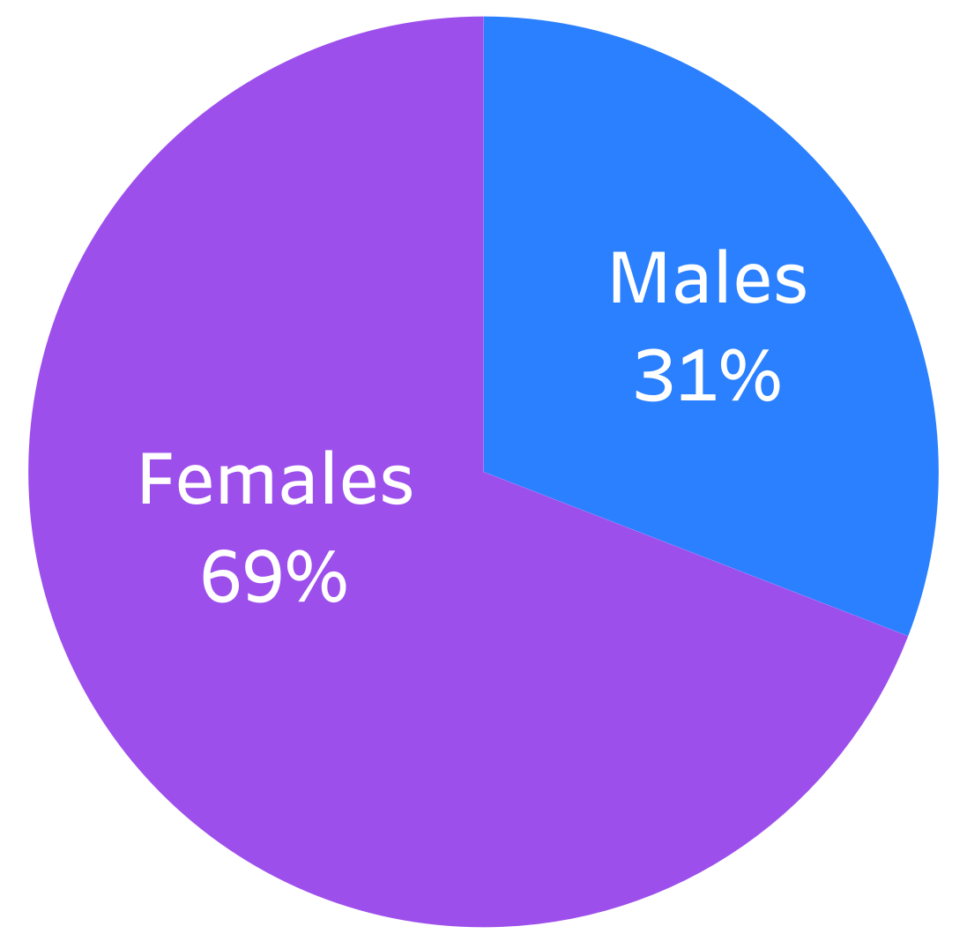
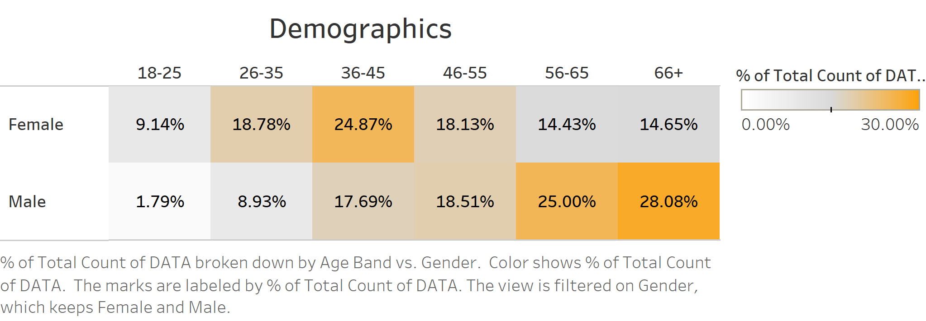
Overview of participants involved
A higher percentage of FEMALES were between 36-45.
A higher percentage of MALES were 56 and over.
Notes:
We can see the majority of participants involved were Female
By looking at the heatmap, we can see that most female participants were aged between 36-45.
For males the majority were over 56+
It’s also interesting to note, that the participation was low in the 18-25 group.

Slide 5
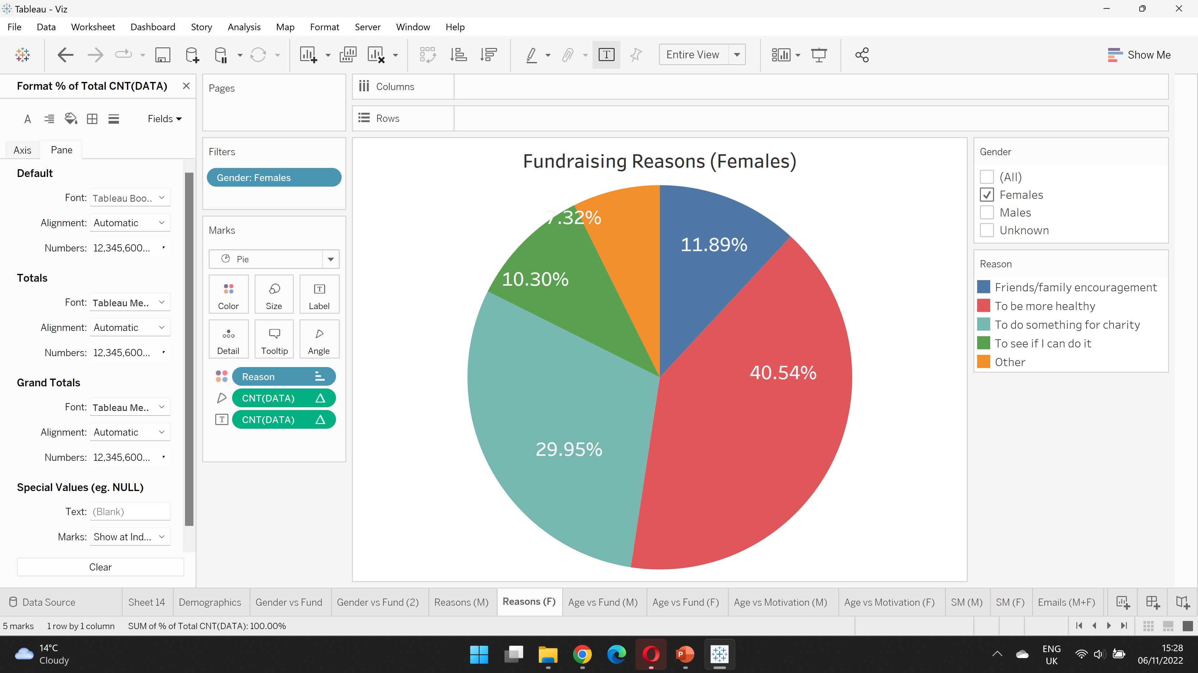
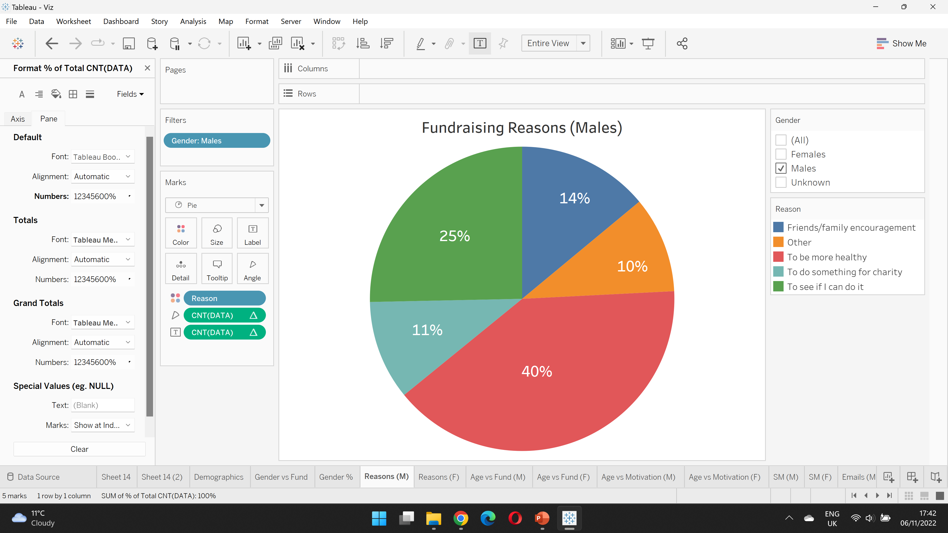
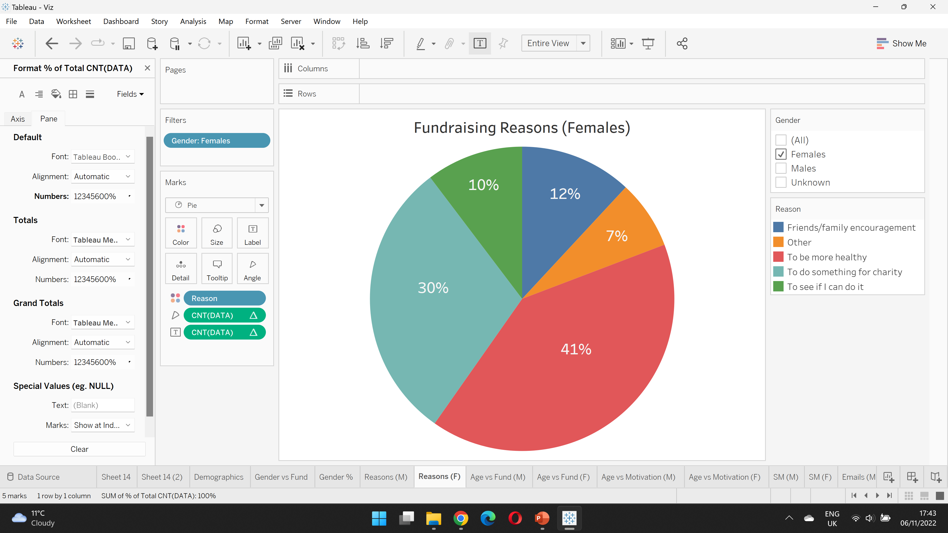
Is there a difference in Fundraising Reasons?
MALES
FEMALES
Notes:
Now lets look at the Fundraising Reasons…
We can clearly see, that the number one reason for people taking part is because they wanted to be more healthy – Around 40%.
In comparison to Males, Females were more likely to take part because they wanted to do something for charity – and that was around 30%
It’s also interesting to note, that the second biggest reason for Males was because they saw it as a challenge – and that was around 25%.

Slide 6
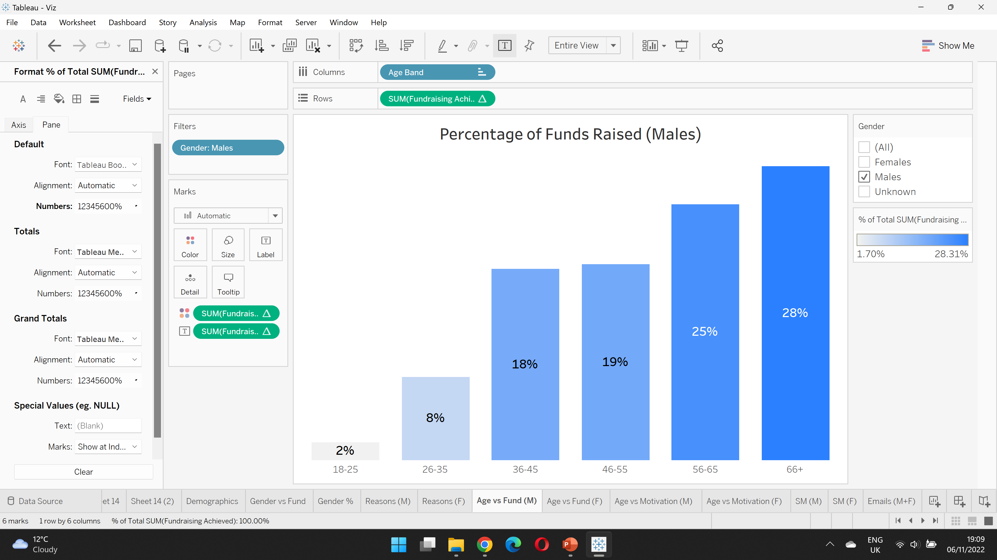
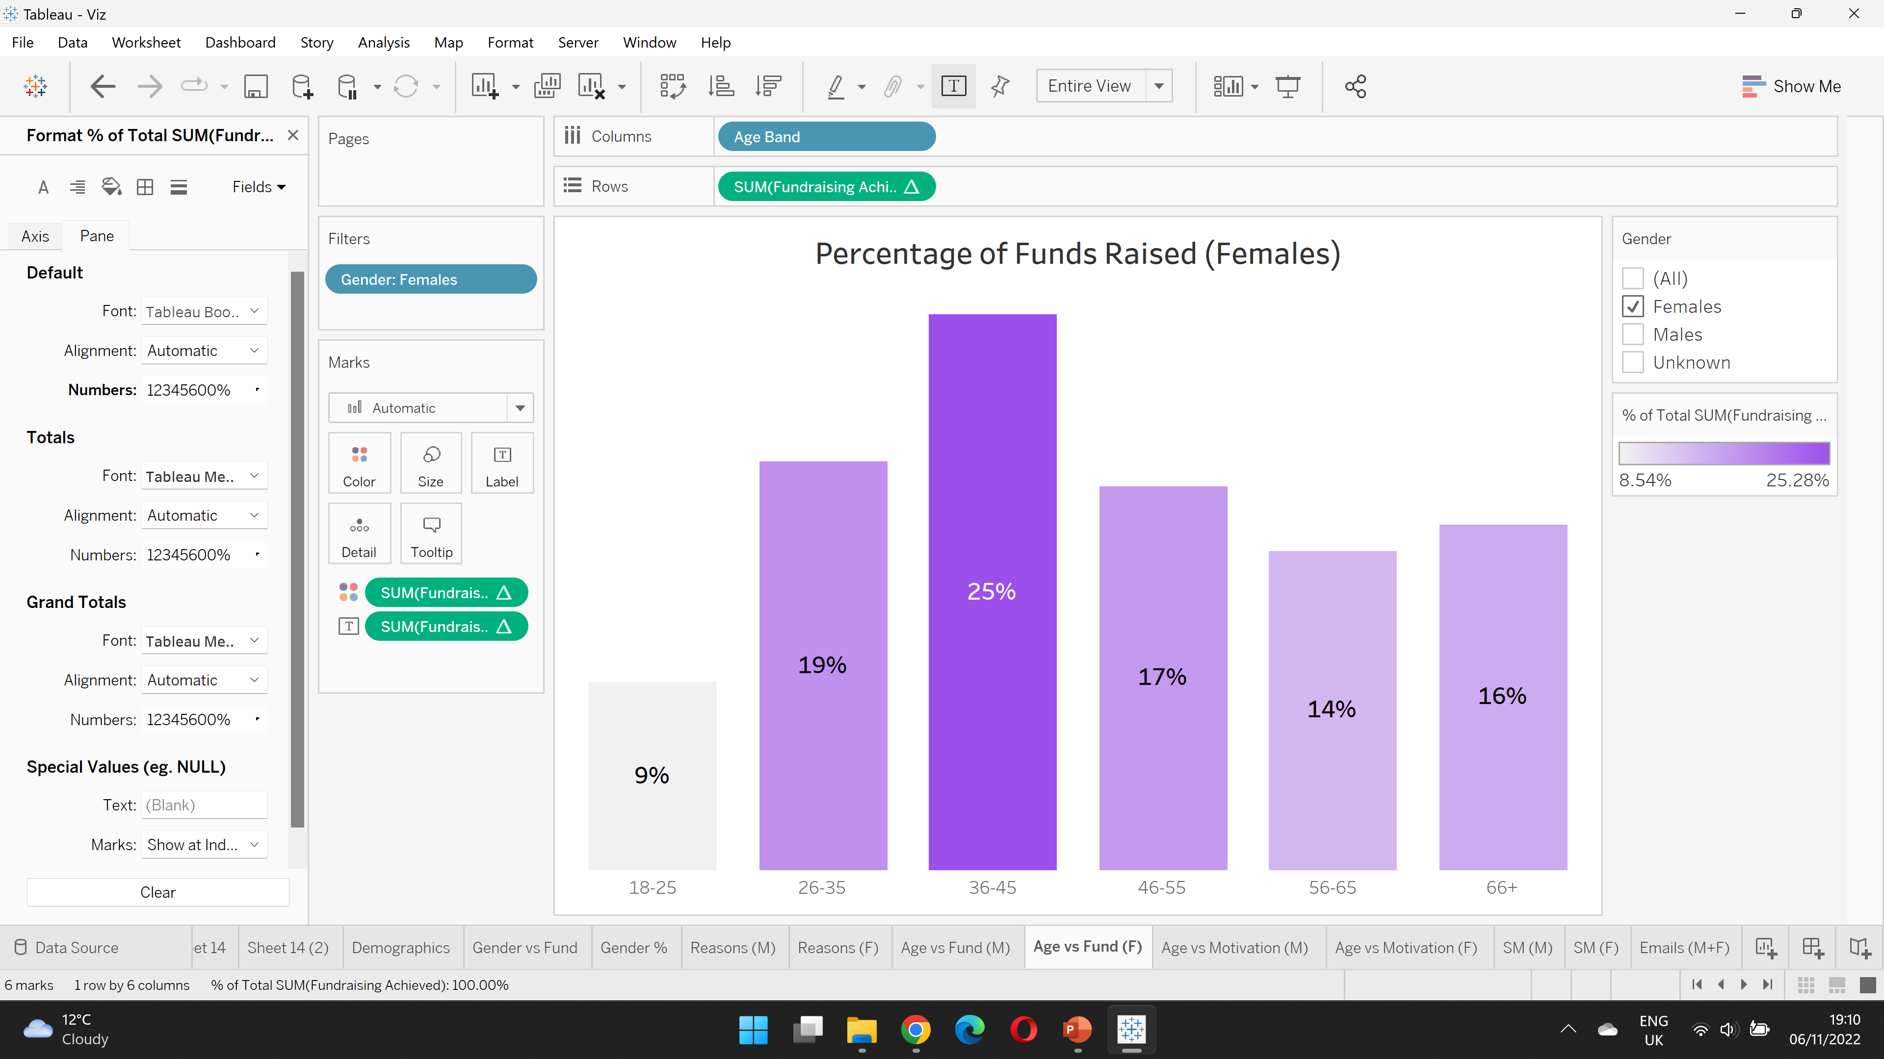
Breakdown of Funds Raised
MALES
FEMALES
Notes:
Here is a breakdown of the funds raised by age group…
We can see that amongst males, the age group that was over 66+ had the highest percentage of funds raised.
For females, the 35-45 age group raised the most.
This makes sense, because earlier we saw these groups contained the most participants.

Slide 7
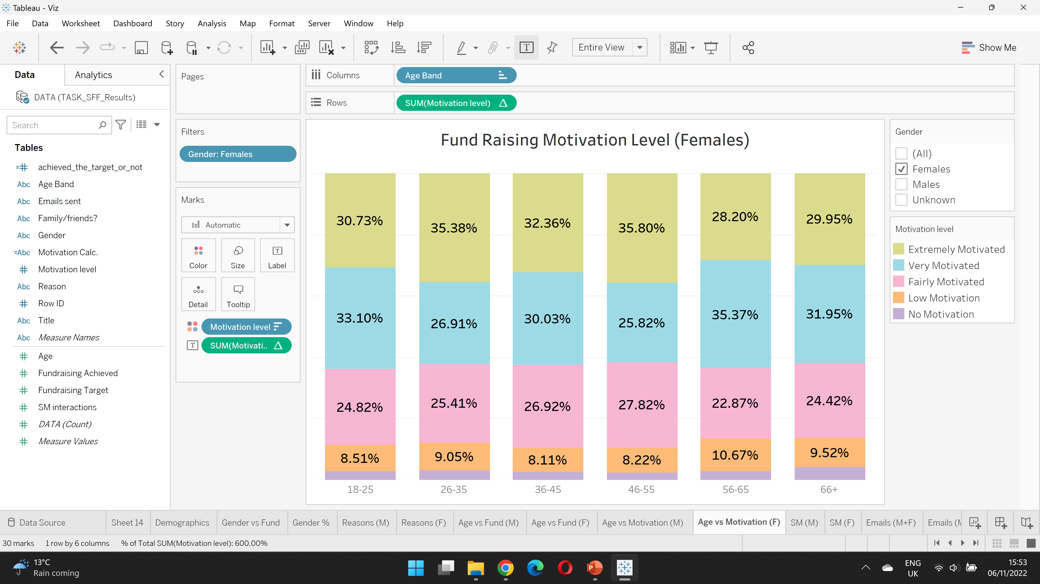
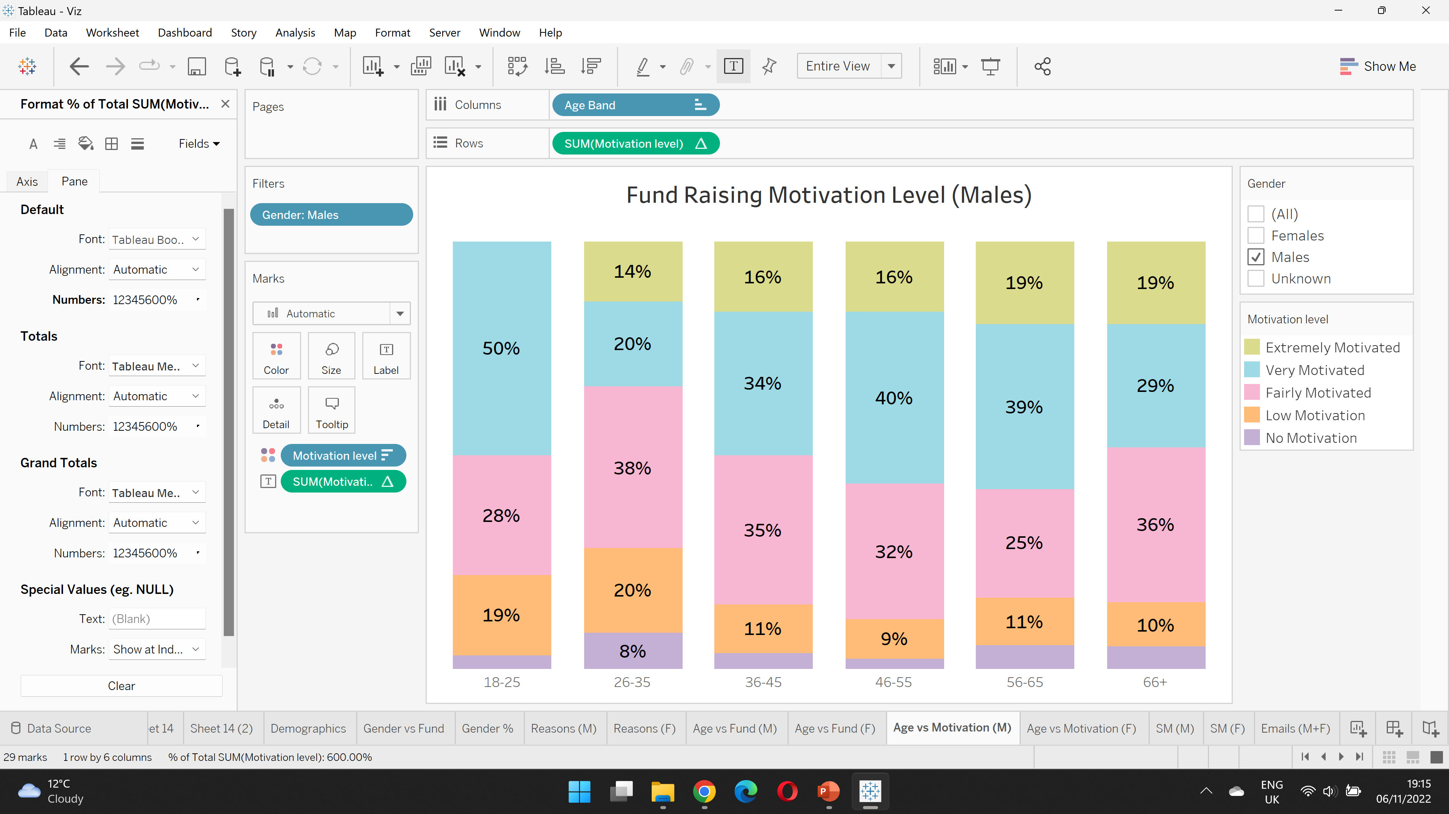
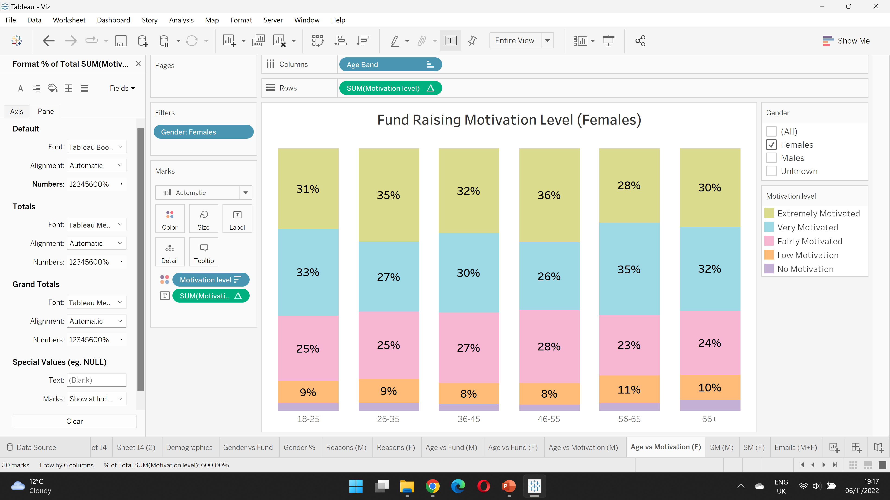
How Motivated were the participants?
MALES
FEMALES
Notes:
How motivated were the participants – Here we can see the scale from Extremely motivated to No motivation.
Firstly if we look at Males – We can see that across the different age groups, most seem to be either Very motivated (blue) or Fairly Motivated (pink).
On the other hand, for Females – Most were either Extremely Motivated (Green) or Very motivated.

Slide 8
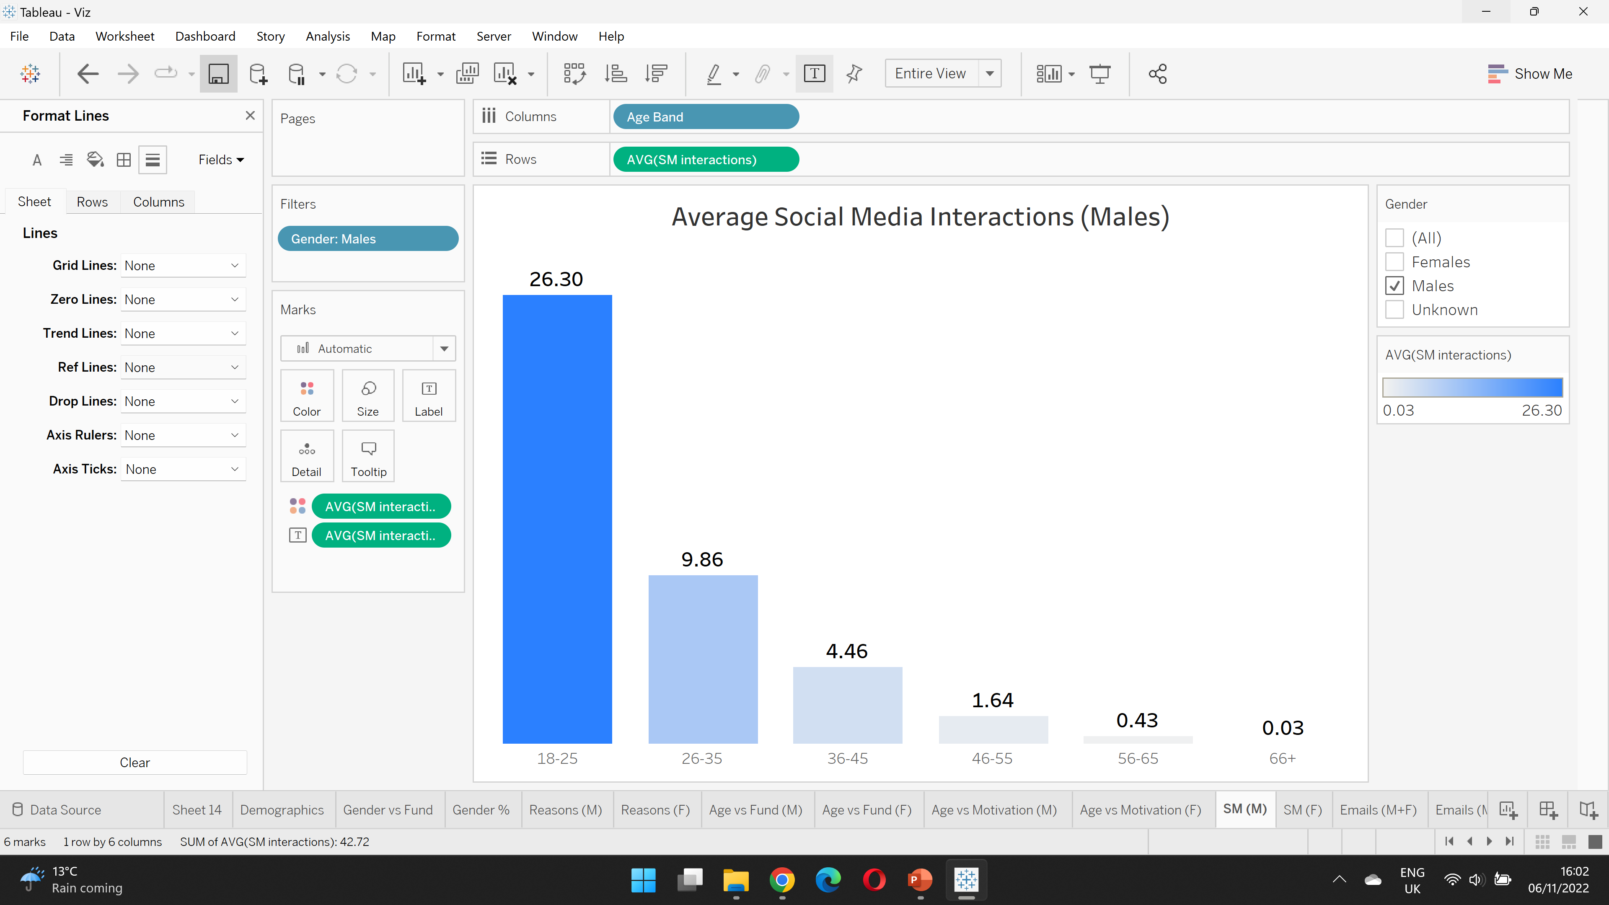
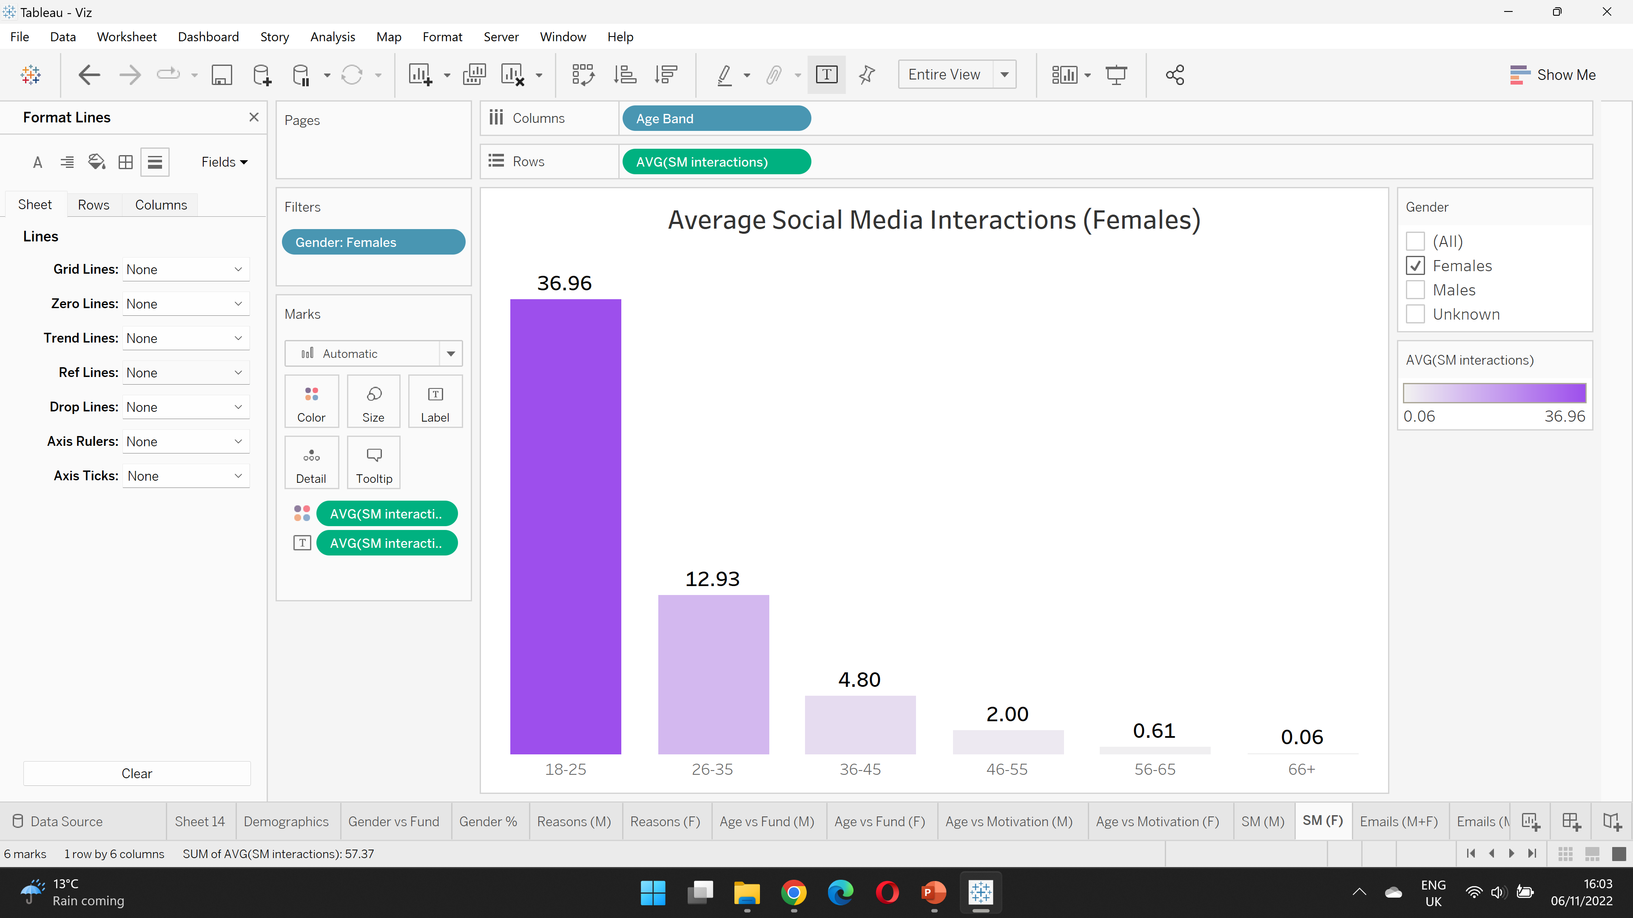
Average Social Media Interactions
MALES
FEMALES
Notes:
If we look at the average social media interactions, we can see that the 18-25 age group is the most active in both. That’s not surprising considering how much time young people spend on social media.
Even though the participants for this age groups are low, we could perhaps engage with them more over social media to spread awareness of the next campaign.

Slide 9
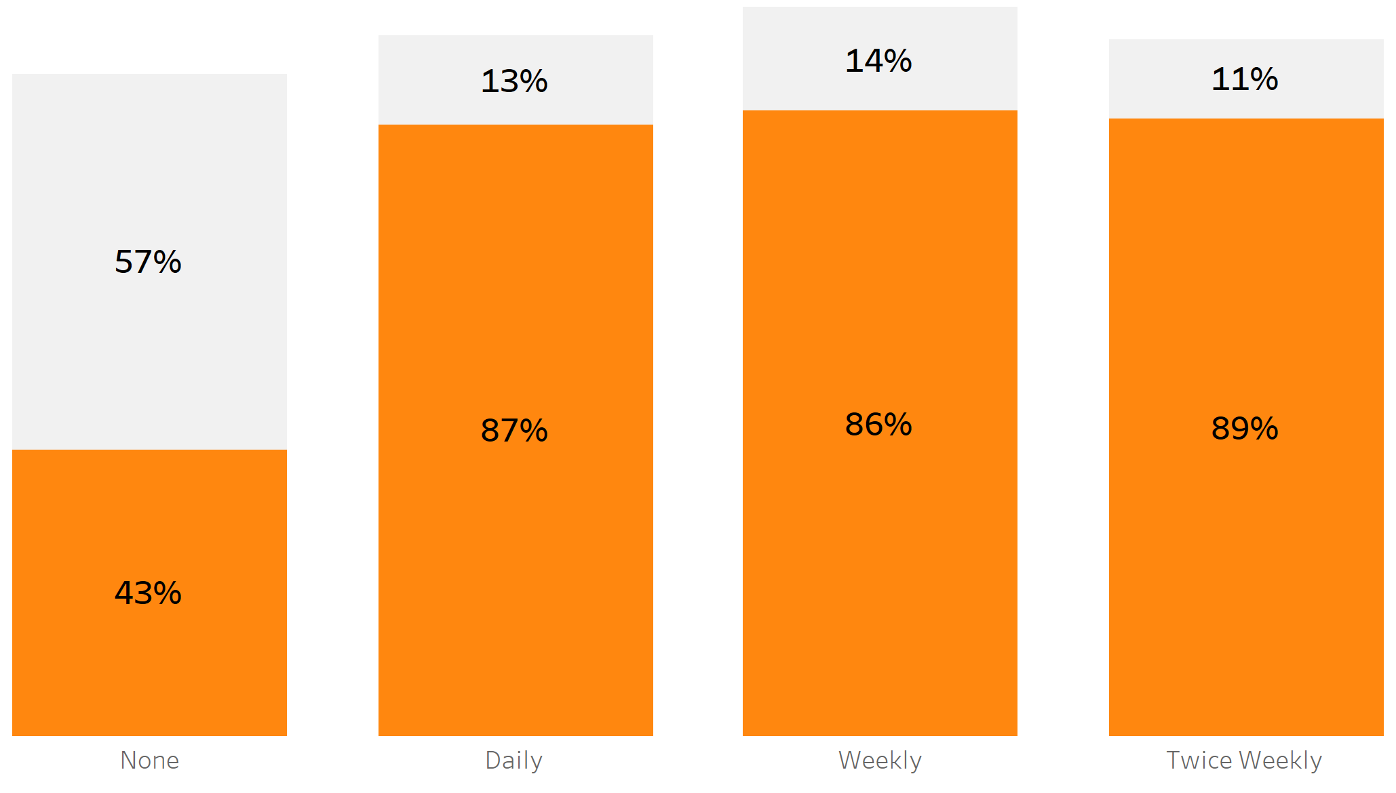
Do encouragement Emails help participants?
Target Achieved
Target Not Achieved
57%
of people who DID NOT receive any encouragement emails DID NOT hit their target!
>85%
of people who DID receive either daily, weekly or twice weekly encouragement emails DID hit their target!
Notes:
Here is a breakdown of the frequency of encouragement emails sent and the percentage of people who hit their target in orange and those that did not hit their target in grey.
We can see by looking at the first bar graph – 57% of people who did not receive any emails did not hit their target.
While the majority of people that did receive an email hit their target. So it’s always better send an email compared to not sending an email.

Slide 10
Conclusions and Suggestions for Future Campaigns
Overall the campaign was a success as the majority of participants hit their target.
The campaign could be improved by sending either weekly or twice encouragement emails to everyone.
How was the campaign originally advertised? – Increase the reach of the SSF social media page by creating engaging content to target the younger the generation to increase participation.
Notes:
Overall, the campaign was a success.
It would be more time and cost effective to not send daily emails. Because sending weekly or twice weekly emails has a similar impact in terms of participants hitting their target.
But the main take away is that emails should be sent to everyone involved and no one should be missed out.
Social Media is a powerful tool, so it can definitely be used to increase awareness of the next campaign and get more people involved.

Slide 11

THE END
THANK YOU FOR LISTENING
Sources:
https://news.cancerresearchuk.org/2015/07/17/giving-sugar-its-fix-public-health-england-recommends-halving-sugar-consumption-targets/
https://news.cancerresearchuk.org/2020/10/20/sugar-and-cancer-what-you-need-to-know/

